Slide 1
Linear Algebra

Slide 2
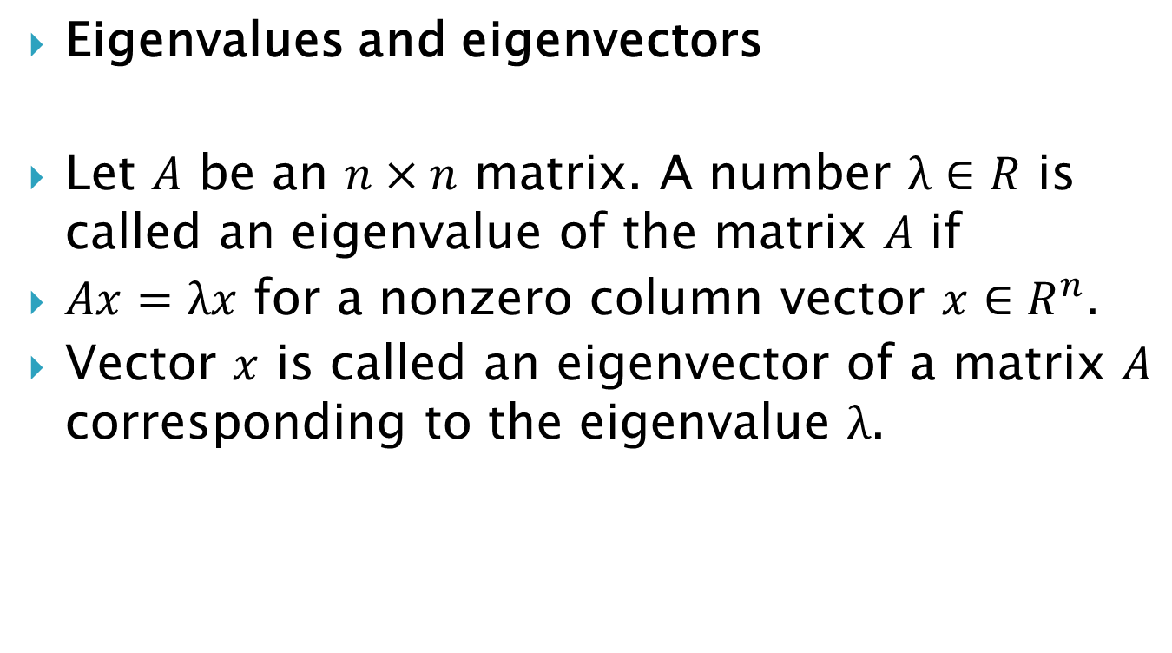
Eigenvalues and eigenvectors
Let $A$ be an $n×n$ matrix. A number $λ∈R$ is called an eigenvalue of the matrix $A$ if
$Ax=λx$ for a nonzero column vector $x∈R^{n}$.
Vector $x$ is called an eigenvector of a matrix $A$ corresponding to the eigenvalue $λ$.

Slide 3
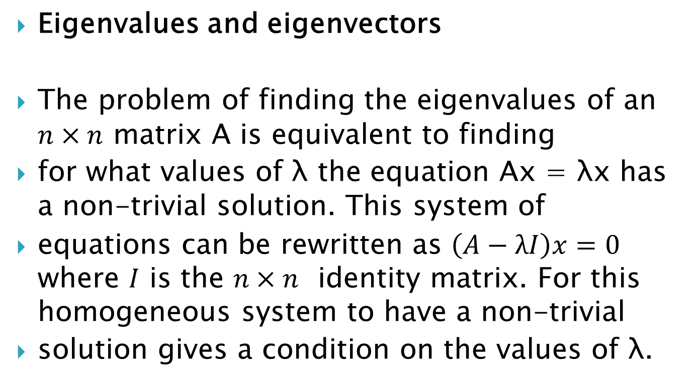
Eigenvalues and eigenvectors
The problem of finding the eigenvalues of an $n×n$ matrix A is equivalent to finding
for what values of λ the equation Ax = λx has a non-trivial solution. This system of
equations can be rewritten as $\left(A−λI\right)x=0$ where $I$ is the $n×n$ identity matrix. For this homogeneous system to have a non-trivial
solution gives a condition on the values of λ.

Slide 4
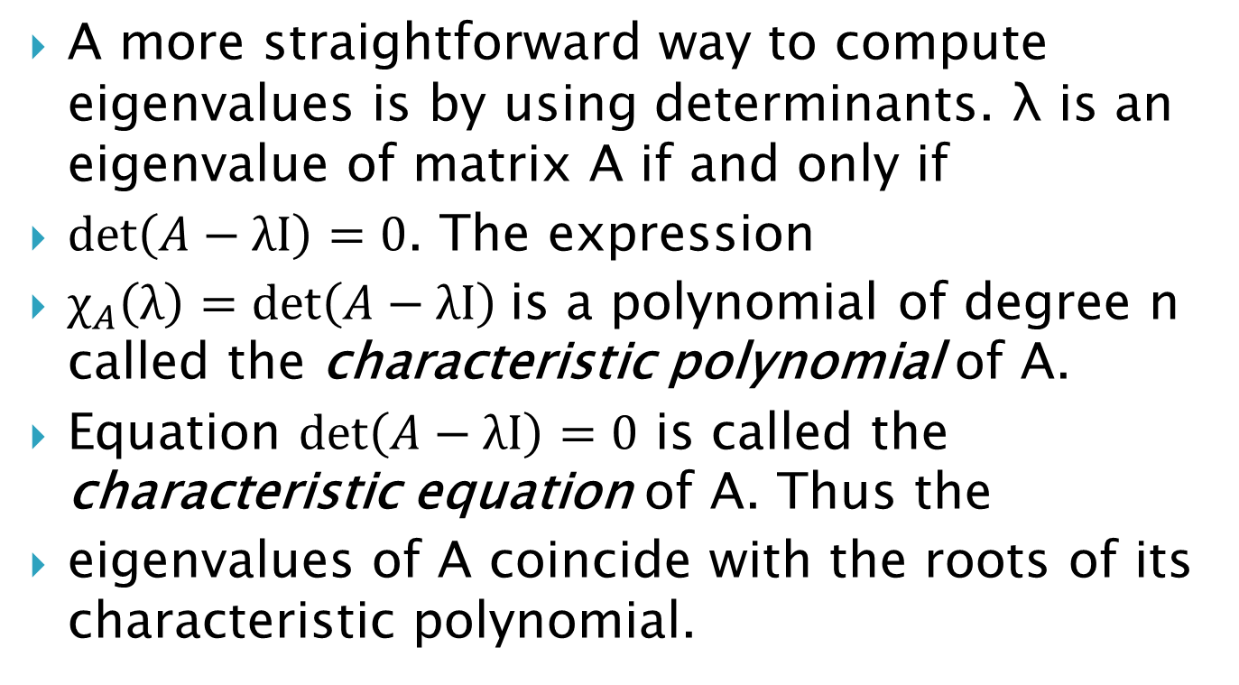
A more straightforward way to compute eigenvalues is by using determinants. λ is an eigenvalue of matrix A if and only if
$\det\left(A−λI\right)=0$. The expression
$χ_{A}\left(λ\right)=\det\left(A−λI\right)$is a polynomial of degree n called the characteristic polynomial of A.
Equation $\det\left(A−λI\right)=0$ is called the characteristic equation of A. Thus the
eigenvalues of A coincide with the roots of its characteristic polynomial.

Slide 5
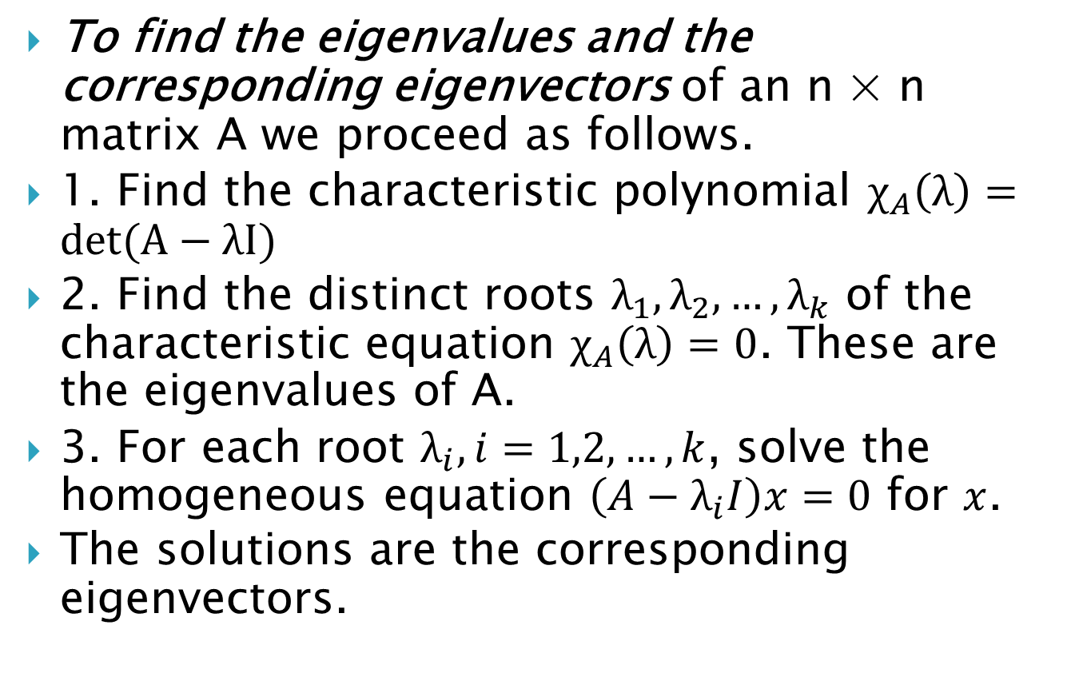
To find the eigenvalues and the corresponding eigenvectors of an n × n matrix A we proceed as follows.
1. Find the characteristic polynomial $χ_{A}\left(λ\right)=\det{(A−λI)}$
2. Find the distinct roots $λ_{1}, λ_{2}, …, λ_{k}$ of the characteristic equation $χ_{A}\left(λ\right)=0$. These are the eigenvalues of A.
3. For each root $λ_{i}, i=1,2,…,k$, solve the homogeneous equation $\left(A−λ_{i}I\right)x=0$ for $x$.
The solutions are the corresponding eigenvectors.

Slide 6

Example 1. Find the eigenvalues and eigenvectors of
$A=\left(\begin{matrix}1 & 0 & 0 \\ 0 & 1 & 1 \\ 0 & 1 & 1\end{matrix}\right)$

Slide 7
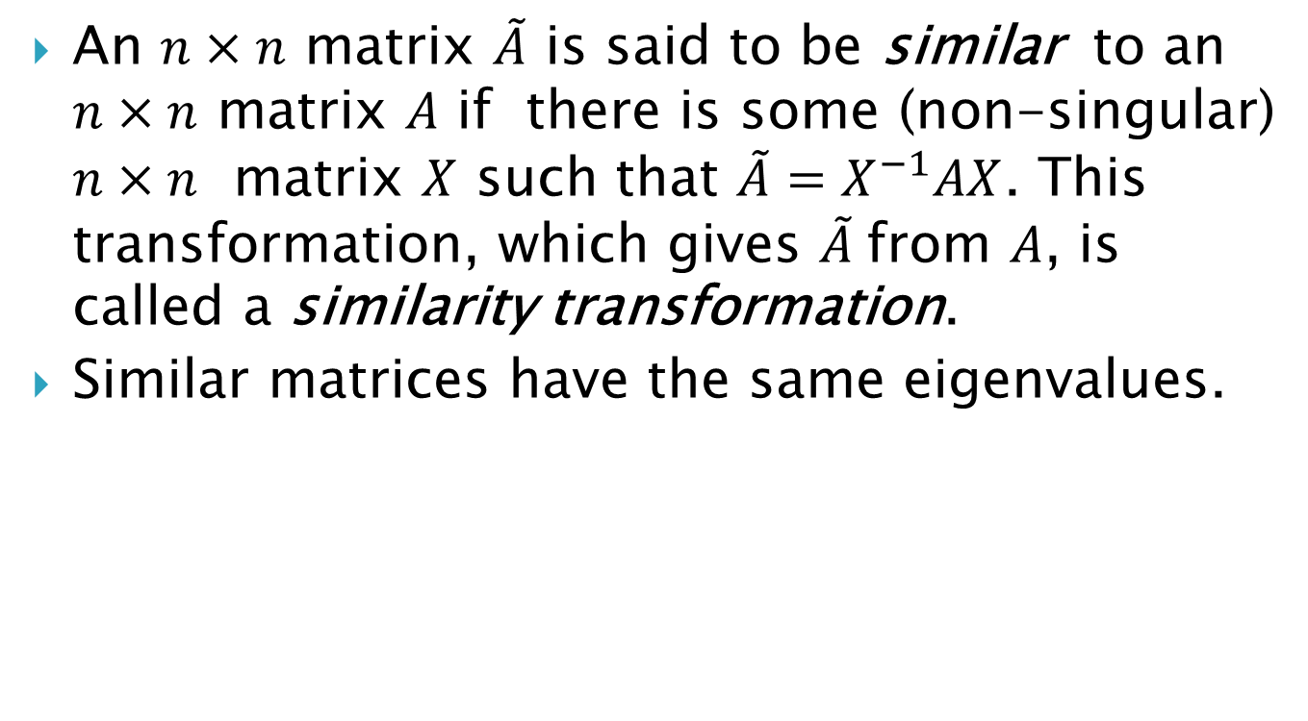
Diagonalisation
An $n×n$ matrix $\tilde{A}$ is said to be similar to an $n×n$ matrix $A$ if there is some (non-singular) $n×n$ matrix $X$ such that $\tilde{A}=X^{−1}AX$. This transformation, which gives $\tilde{A}$from $A$, is called a similarity transformation.
Similar matrices have the same eigenvalues.

Slide 8
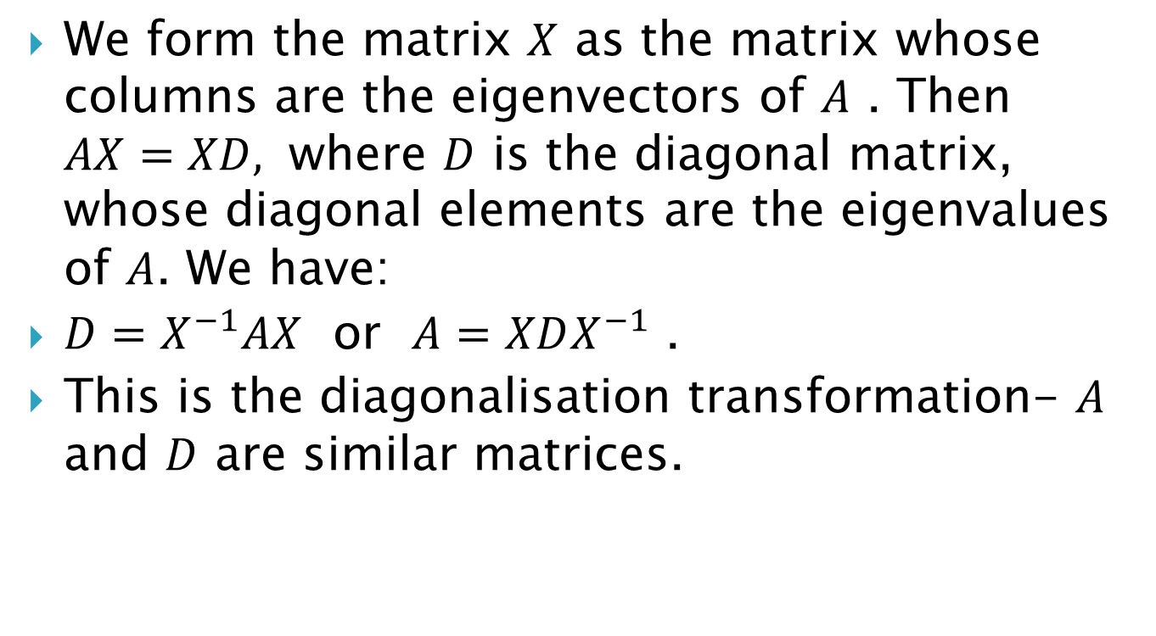
We form the matrix $X$ as the matrix whose columns are the eigenvectors of $A$ . Then $AX=XD,$ where $D$ is the diagonal matrix, whose diagonal elements are the eigenvalues of $A$. We have:
$D=X^{−1}AX$ or $A=XDX^{−1}$ .
This is the diagonalisation transformation- $A$ and $D$ are similar matrices.

Slide 9
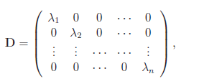
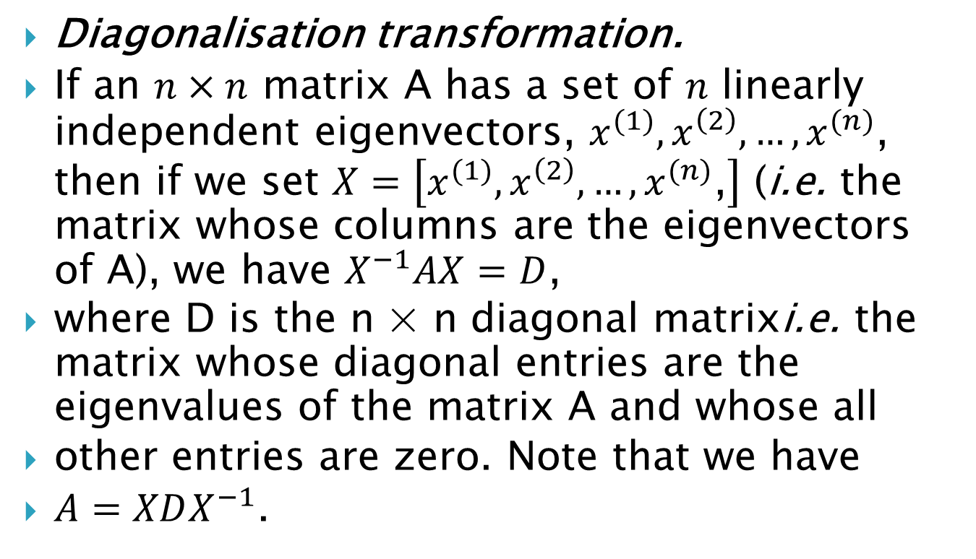
Diagonalisation transformation.
If an $n×n$ matrix A has a set of $n$ linearly independent eigenvectors, $x^{(1)}, x^{\left(2\right)}, …, x^{(n)}$, then if we set $X=\left[x^{(1)}, x^{\left(2\right)}, …, x^{(n)}\text{,}\right]$ (i.e. the matrix whose columns are the eigenvectors of A), we have $X^{−1}AX=D$,
where D is the n × n diagonal matrixi.e. the matrix whose diagonal entries are the eigenvalues of the matrix A and whose all
other entries are zero. Note that we have
$A=XDX^{−1}$.

Slide 10
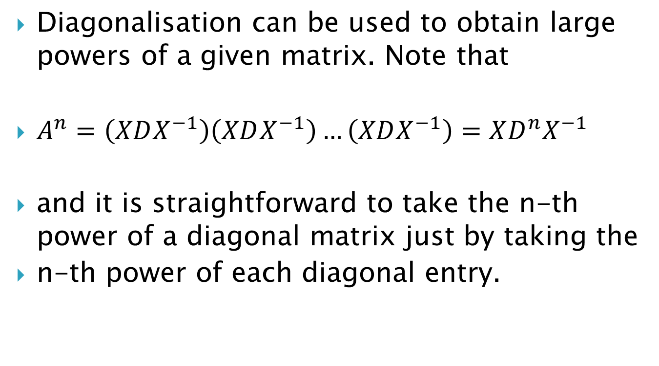
Diagonalisation can be used to obtain large powers of a given matrix. Note that
$A^{n}=\left(XDX^{−1}\right)\left(XDX^{−1}\right)…\left(XDX^{−1}\right)=XD^{n}X^{−1}$
and it is straightforward to take the n-th power of a diagonal matrix just by taking the
n-th power of each diagonal entry.

Slide 11
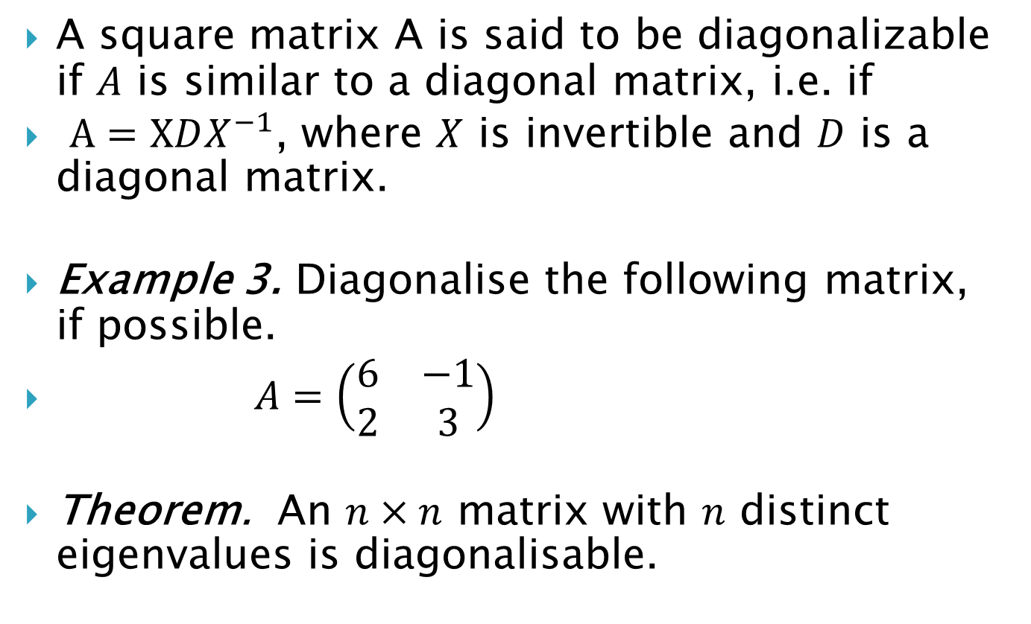
A square matrix A is said to be diagonalizable if $A$ is similar to a diagonal matrix, i.e. if
$A=XDX^{−1}$, where $X$ is invertible and $D$ is a diagonal matrix.
Example 3. Diagonalise the following matrix, if possible.
$A=\left(\begin{matrix}6 & −1 \\ 2 & 3\end{matrix}\right)$
Theorem. An $n×n$ matrix with $n$ distinct eigenvalues is diagonalisable.

Slide 12
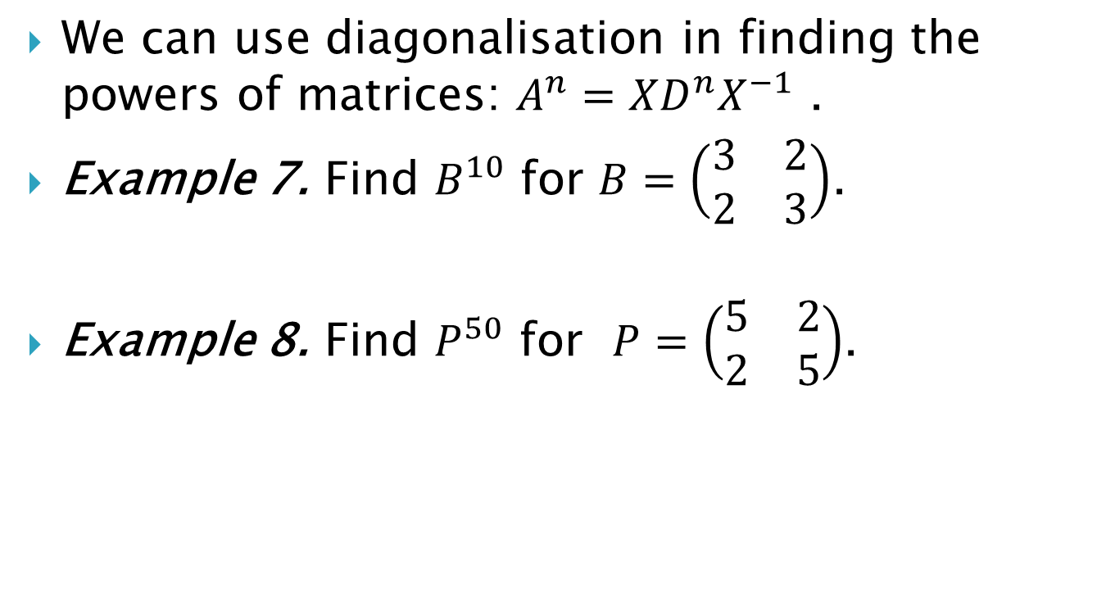
We can use diagonalisation in finding the powers of matrices: $A^{n}=XD^{n}X^{−1}$ .
Example 7. Find $B^{10}$ for $B=\left(\begin{matrix}3 & 2 \\ 2 & 3\end{matrix}\right)$.
Example 8. Find $P^{50}$ for $P=\left(\begin{matrix}5 & 2 \\ 2 & 5\end{matrix}\right)$.

